Slide 1
Introduction to Pharmacokinetics Novartis-Academia Hackathon
Pharmacometrics
Andrew Stein, PhD
Associate Director Pharmacometrics
Cambridge, MA August 2019

Slide 2
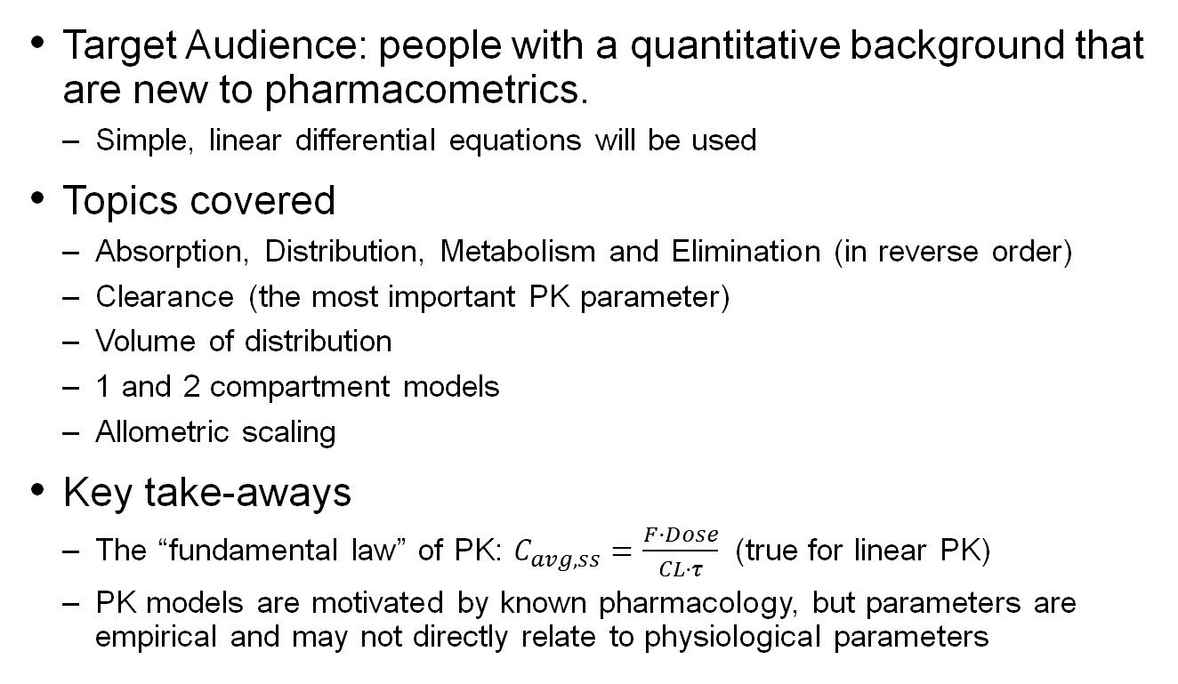
Overview
Target Audience: people with a quantitative background that are new to pharmacometrics.
Simple, linear differential equations will be used
Topics covered
Absorption, Distribution, Metabolism and Elimination (in reverse order)
Clearance (the most important PK parameter)
Volume of distribution
1 and 2 compartment models
Allometric scaling
Key take-aways
The “fundamental law” of PK: $C_{avg,ss}=\frac{F·Dose}{CL·τ}$ (true for linear PK)
PK models are motivated by known pharmacology, but parameters are empirical and may not directly relate to physiological parameters

Slide 3
Acknowledgements (Based on material from)
Rowland, M., Tozer, T. N. Clinical pharmacokinetics and pharmacodynamics: concepts and applications
Peter Bonate, Astellas
Richard Brundage, U Minnesota
Leon Aarons, U Manchester
Jean-Louis Steimer, Novartis
Martin Fink, Novartis
Nick Holford, U Auckland http://holford.fmhs.auckland.ac.nz/Teaching/pharmacometrics/advanced.php

Slide 4

Motivation – the importance of finding the right dose of a drug
Tylenol helps to reduce pain and fever and is safe at daily doses ≤3,000 mg/day
>5,000 mg/day can cause liver damage
>10,000 mg/day can be lethal.
You can learn about safety and efficacy from clinical trials
Making best use of this data requires models to integrate the data
(paracetamol)
Notes:
You can learn a

Slide 5
The “PKPD” pathway of drug effect
Absorbed by intestines into blood
Distribute from blood into tissue
Binds target in tissue
Effects
Oral Dose
Drug Concentration
Measurement
Elimination
from body
Pharmacokinetics (PK):
How body affects drug
Pharmacodynamics (PD):
How drug affects body
What dose is needed to shrink a tumor without causing severe neutropenia
Should children and adults receive the same dose?

Slide 6
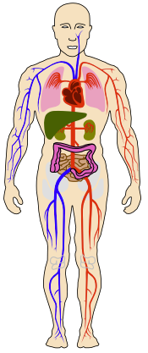
Measuring PKPD
Dose Regimen
amount given
frequency
method (oral, patch, etc.)
PK (Pharmacokinetics) example
Measurement of drug concentration from circulation
PD (Pharmacodynamics) example
Change in tumor size, as measured by X-Ray

Slide 7
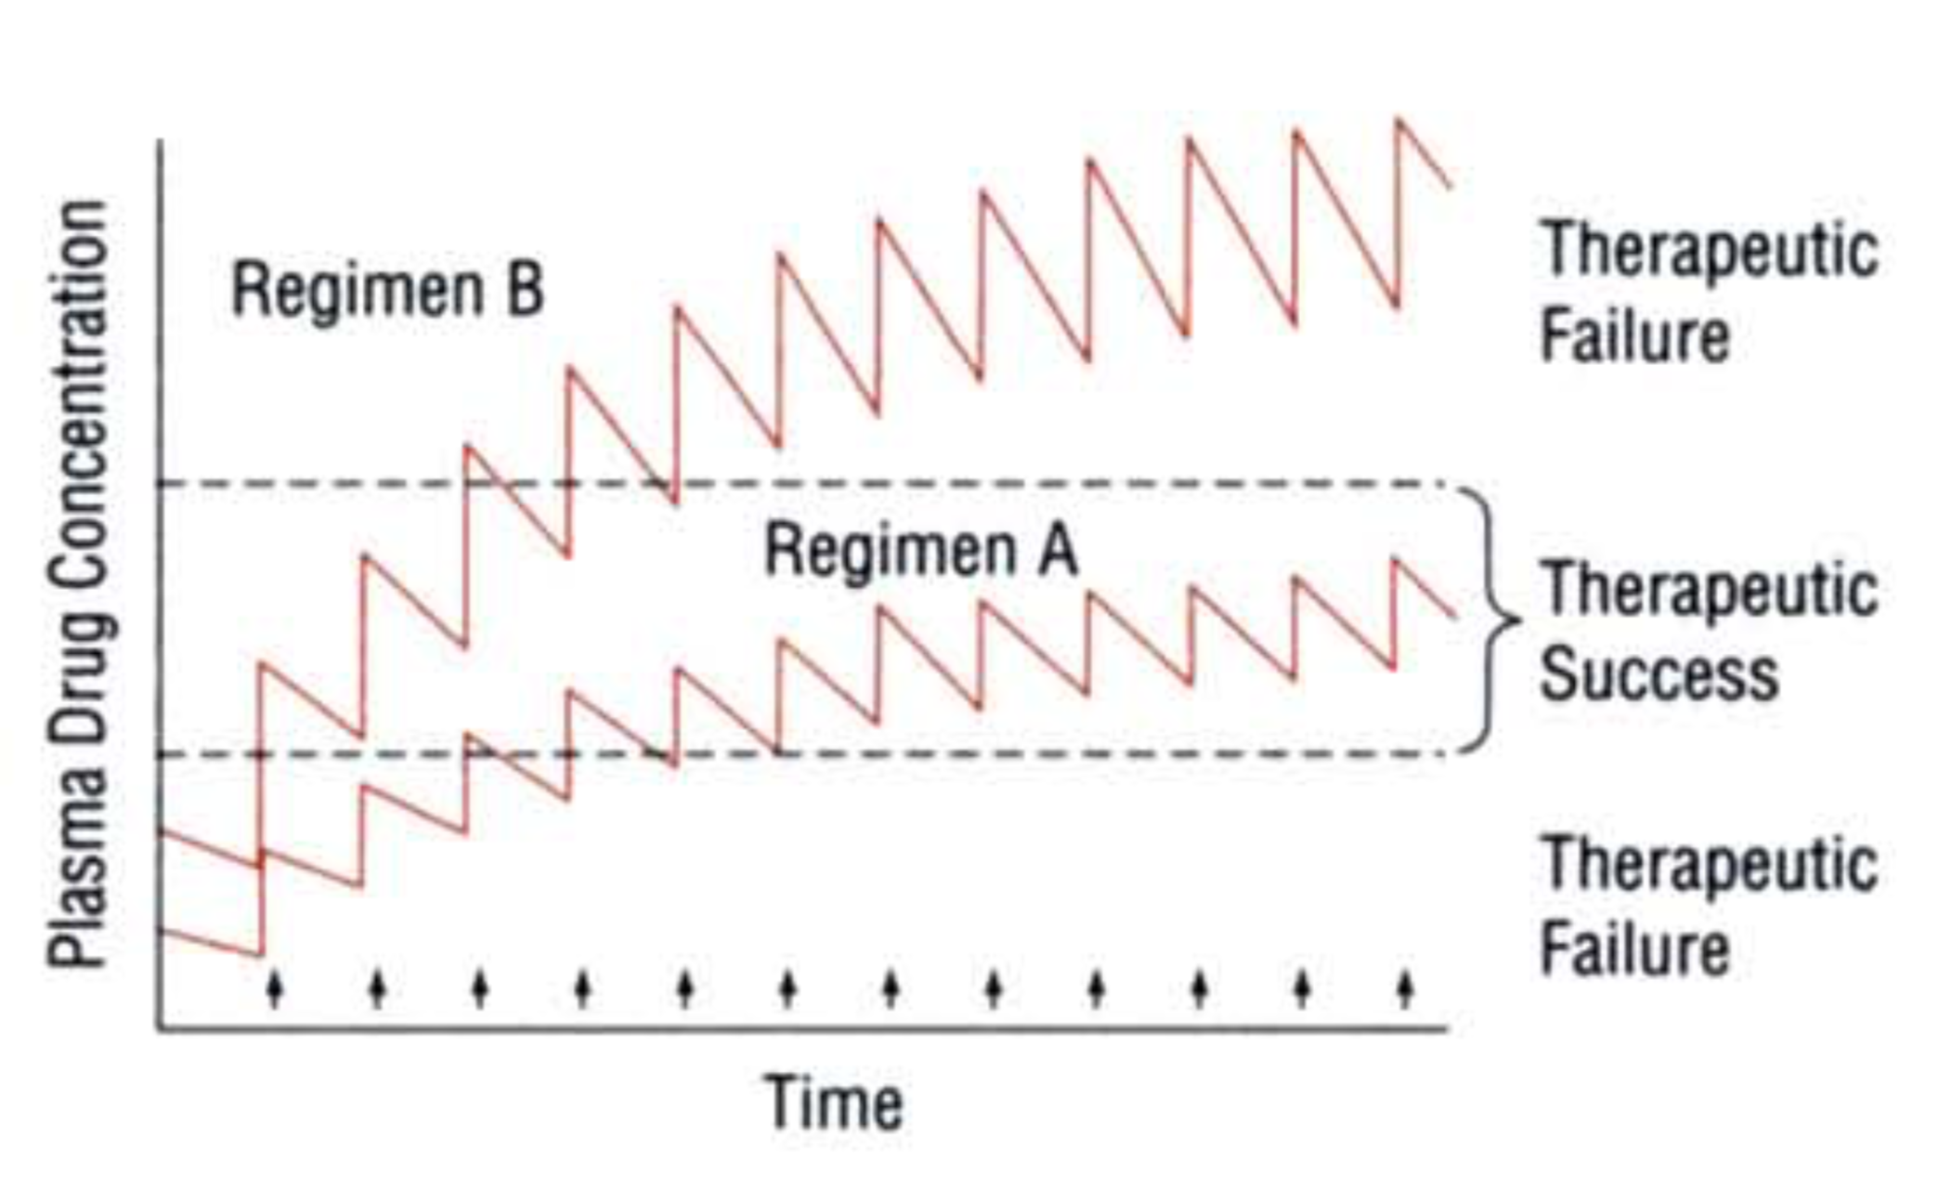
Understanding PKPD can help in picking the optimal dose regimen
Drug is too toxic
Drug doesn’t work
From Rowland and Tozer

Slide 8
Types of Drugs
Small Molecule
Antibody
Cell Based
Therapies
~1 nm
500 Da
~10 nm
150,000 Da
100,000 nm
~10¹⁴ Da
Aspirin
Tylenol
Humira
Keytruda
Kymriah
Stem Cell Transplant

Slide 9
Introduction to Pharmacokinetics

Slide 10
Why Do We Measure Blood or Plasma Concentrations When the Site of Action is Someplace Else?

Slide 11
Key process of pharmacokinetics (ADME)
Absorption
Distribution
Metabolism
Excretion

Slide 12
Volume of Distribution

Slide 13
Key Lessons
For intravenous dose
Initial Concentration = Dose/Volume
Volume is a “theoretical concept” and does not necessarily reflect blood or body volume

Slide 14
Definition of dose and concentration
Dose
Measurement: Mass
Units: mg
Concentration (C)
Measurement: Mass/Volume
Units: mg/ml
Volume of distribution (V)
“Theoretical Volume” needed to contain administered drug at the measured concentration
Key Formula
Right after IV dosing (time = 0)
C(0) = Dose/V → V = Dose/C₀

Slide 15
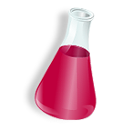
Volume of distribution example C₀ = Dose/V or Dose=C₀·V
Drug Concentration
in Beaker
Drug Concentration
with Activated Charcoal
(absorbs drug)
Dose = 1000 mg
C₀ = 20 mg/mL
V = 50 mL
Dose = 1000 mg
C₀ = 0.2 mg/mL
V = 5000 mL
From Pete Bonate

Slide 16
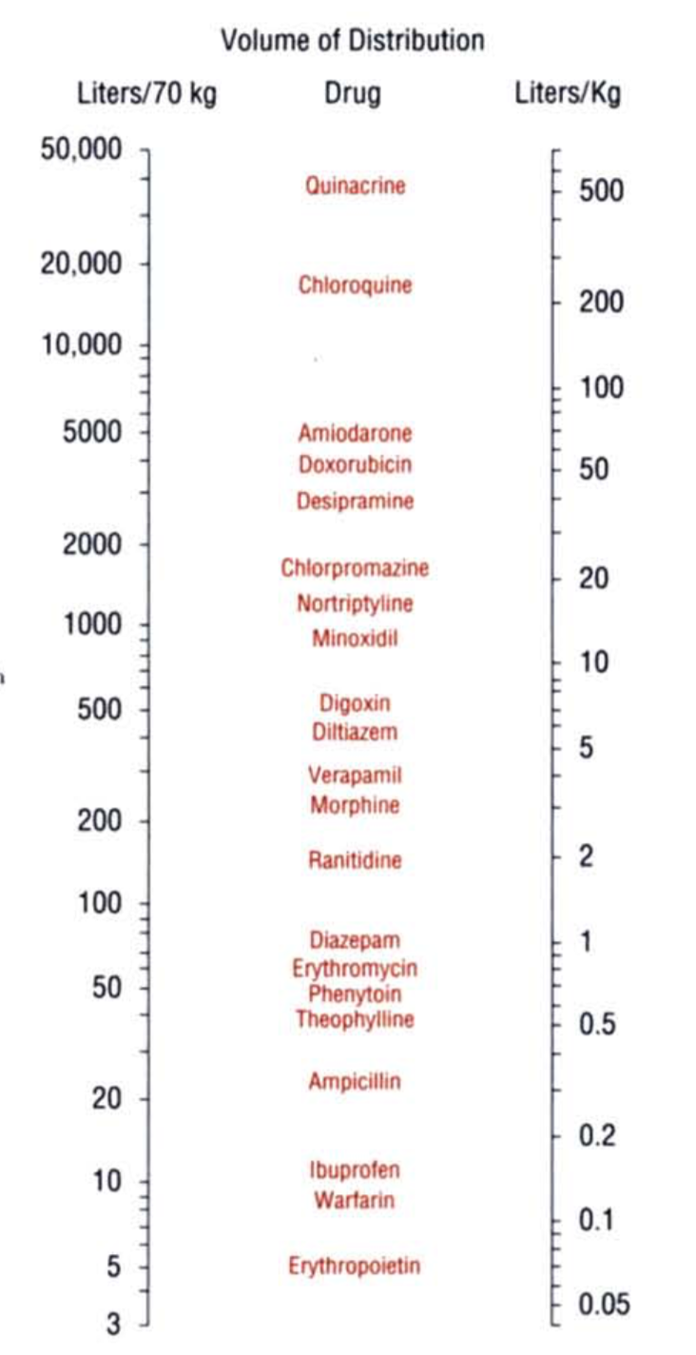
Volumes for different drugs
Volume (L)
~ Dose/C(0)
Drug
Chloroquine
10,000
Doxorubicin
1000
Morphine
100
Total Body = 70
Erythromycin
Total Body Water = 42
10
Pembrolizumab (antibody)
Blood Volume = 5
Erythropoietin
3

Slide 17
How can chloroquine have a volume of 10,000L, when blood volume is 5L?
A drug may appear to have a larger volume if
It is lipophilic (sticks to fat, instead of water) and distributes to body and is not observed in blood.
Accumulates in red blood cells and not present in the plasma sample
Key lesson: Volume (and all PK parameters) are “apparent” and cannot always be easily related to physiological properties
10,000 L
https://www.watertankfactory.com.au/water-tanks/r10000-litre-rainwater-tank/

Slide 18
Key Lessons
Volume of distribution relates amount in body to concentration measured in circulation.
Volume of distribution is not necessarily physiologically meaningful and can be as large as 10,000 L.

Slide 19
Pharmacokinetics after single intravenous bolus dose

Slide 20
Examples of intravenous drugs
Chemotherapies (doxorubicin)
Pain medications (morphine)
Increase blood pressure (epinepherine)

Slide 21
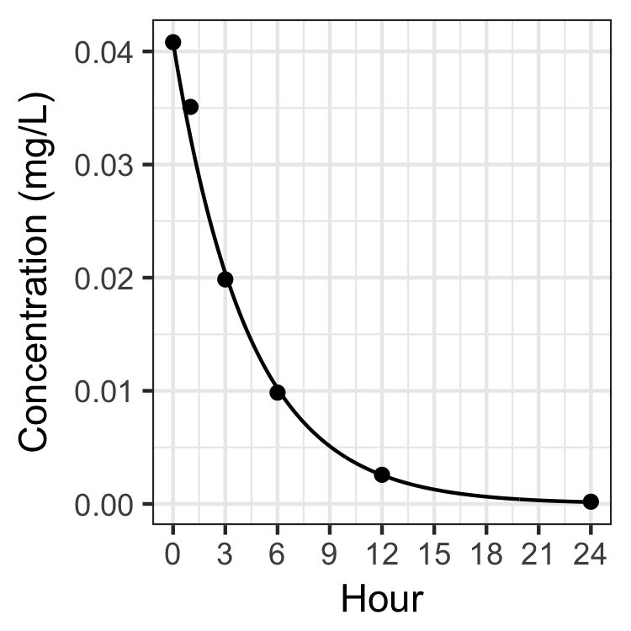
Drug concentration over time
Dose = 10 mg
C₀ = 0.04 mg/L
V = Dose/C₀
= 250 L

Slide 22
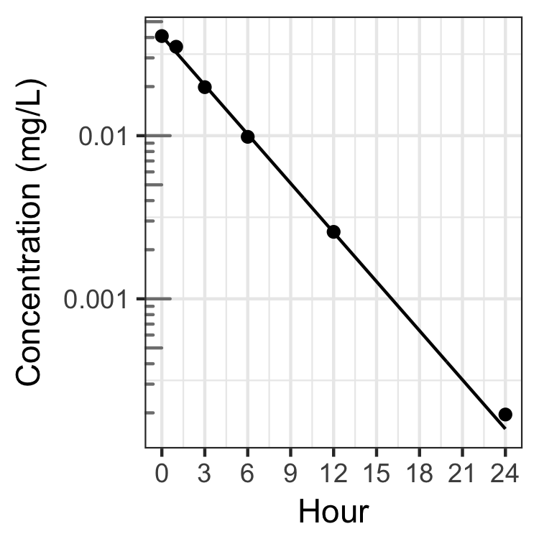
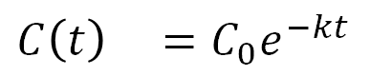
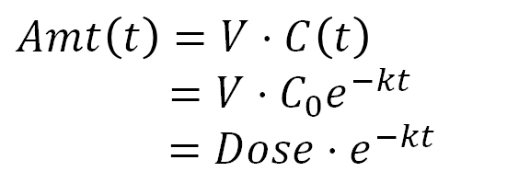
Drug concentration over time Log scale
Dose = 10 mg
C₀ = 0.04 mg/L
V = 250 L
k
k = 0.23/h
= elimination rate
units = 1/time
$$C\left(t\right) =C_{0}e^{−kt}$$
$$Amt\left(t\right)=V·C\left(t\right)$$
$=V·C_{0}e^{−kt}$
$$=Dose{·e}^{−kt}$$

Slide 23
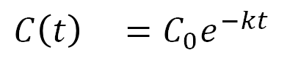
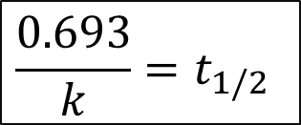
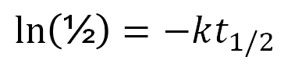
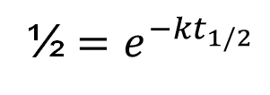
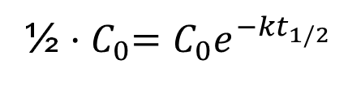
Half-life definition – how long for half of drug to be eliminated
How long does it take for half the drug to be eliminated?
$$C\left(t\right) =C_{0}e^{−kt}$$
At what time does:
½ ${·C}_{0}=C_{0}e^{−kt_{1/2}}$
k
½ $=e^{−kt_{1/2}}$
$$\ln\left(\text{½}\right)=−kt_{1/2}$$
$$\frac{0.693}{k}=t_{1/2}$$

Slide 24
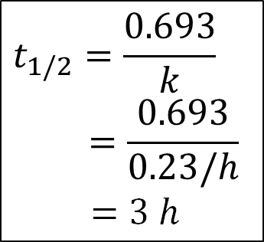
Half-life example
$$C\left(t\right) =C_{0}e^{−kt}$$
0.04 (100%)
0.02 (50%)
0.01 (25%)
0.005 (12%)
0.0025 (6%)
0.00125 (3%)
$$t_{1/2}=\frac{0.693}{k}$$
$$=\frac{0.693}{0.23/h}$$
$=3 h$
k = 0.23/h
Every 3 hours,
concentration declines by half

Slide 25
The shorter the terminal half-life, the more frequently the drug is dosed
Name | Half-life | Dose Frequency
Tylenol | 3 hours | 4 per day
Aleve | 14 hours | 2 per day
Keytruda | 25 days | 1 per 3 weeks
Dosing interval also depends on duration of effect

Slide 26
SEE QUIZ QUESTIONS

Slide 27
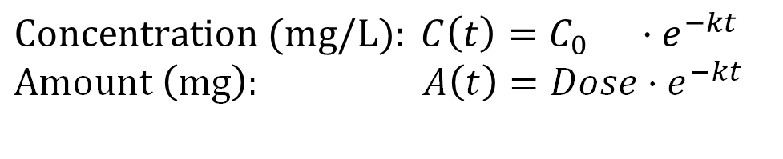
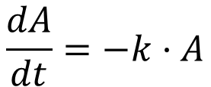
Compartmental Model
Dose
$$Concentration (mg/L): C\left(t\right)=C_{0} ·e^{−kt}$$
$$Amount \left(mg\right): A\left(t\right)=Dose·e^{−kt}$$
A
k
Rate of change of amount in body
$$\frac{dA}{dt}=−k·A$$

Slide 28
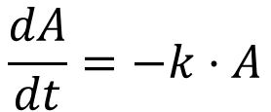
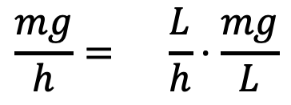
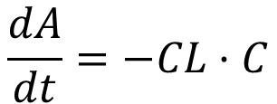
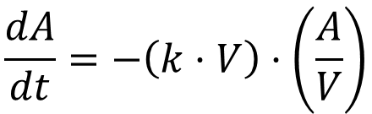
Mathematical introduction to Clearance [L/h]
$$\frac{dA}{dt}=−k·A$$
$$\frac{dA}{dt}=−\left(k·V\right)·\left(\frac{A}{V}\right)$$
$$\frac{dA}{dt}=−CL·C$$
$$\frac{mg}{h}= \frac{L}{h}·\frac{mg}{L}$$
Clearance is a flow rate of plasma that is completely eliminated of drug

Slide 29
Mechanical Analogy
Concentration (C)
Pump (Heart)
Volume (V)
Vessel
Metabolizer (Liver)
Filter (Kidney)
Pump
Flow rate
Filter
From Leon Aarons

Slide 30
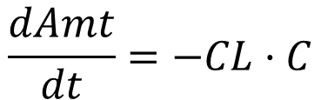
Mechanical Analogy
Concentration (C)
Dose
Pump (Heart)
Volume (V)
Vessel
Metabolizer (Liver)
Filter (Kidney)
Pump
Flow rate (CL)
Perfect
Filter
If filter eliminates all drug that passes through, then CL is the flow rate
$$\frac{dAmt}{dt}=−CL·C$$
From Leon Aarons

Slide 31
Clearance is the most important PK parameter

Slide 32
Clearance is helpful in understanding the average concentration at steady state
After sufficient time under the same dosing regimen, one reaches “steady state”, where
Rate In = Rate Out = CL·C
Let’s say:
You want to maintain concentration ~ 10 mg/L
You know that CL = 3 L/h
Then:
Rate Out = (3 L/h)·(10 mg/L) = 30 mg/h
The maintenance dose (Rate In) is 30 mg/h.

Slide 33
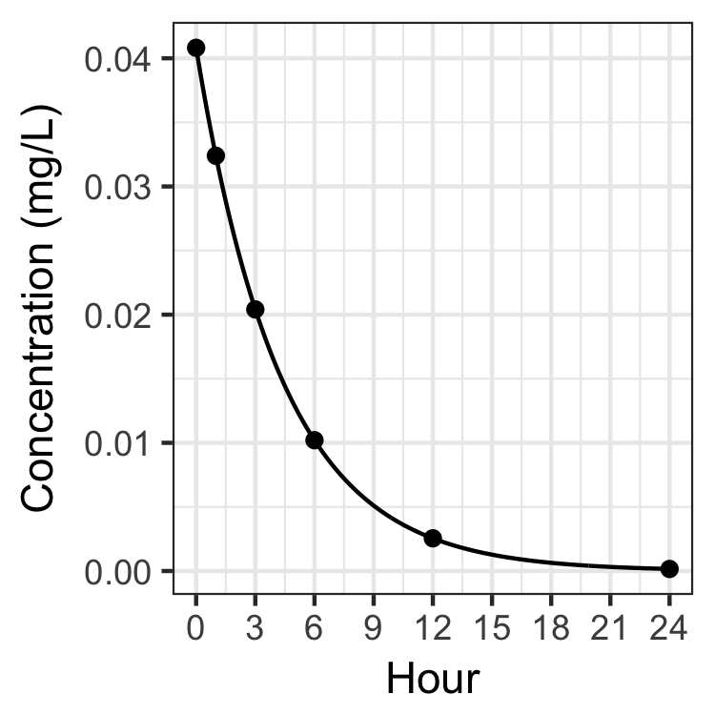
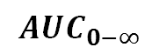
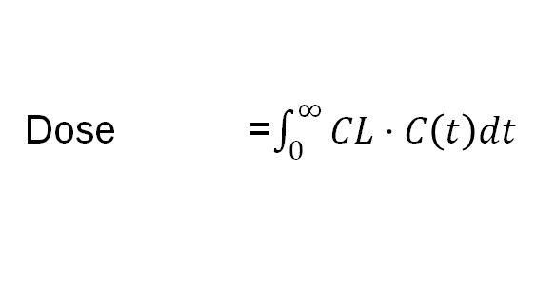
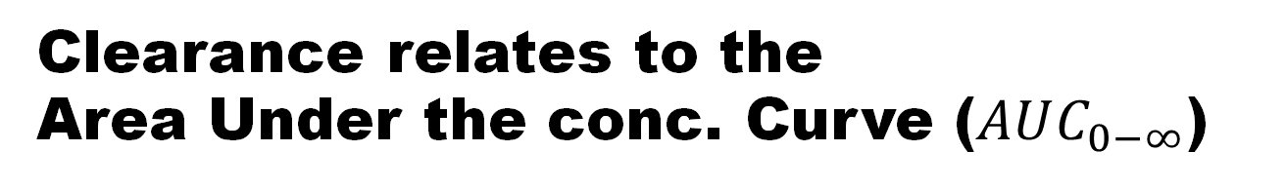
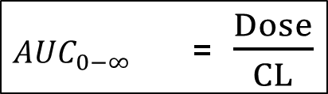
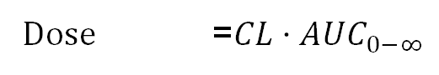
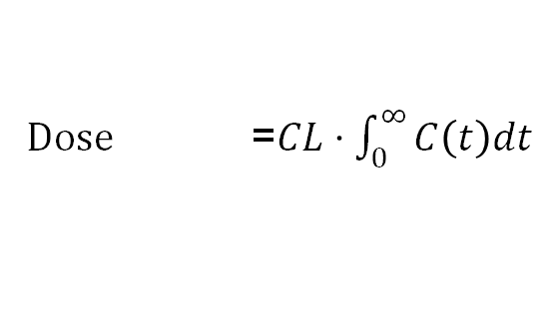
Clearance relates to the Area Under the conc. Curve ($AUC_{0−∞}$)
Total drug in = Total drug out
Dose =$\int_{0}^{∞}{CL·C\left(t\right)dt}$
If clearance does not depend on concentration (linear)
Dose =$CL·\int_{0}^{∞}{C\left(t\right)dt}$
$$AUC_{0−∞}$$
Dose =$CL·AUC_{0−∞}$
$AUC_{0−∞}$ =$\frac{Dose}{CL}$
Formula doesn’t depend on specific model for C(t), Volume or half-life. It only requires linear clearance

Slide 34
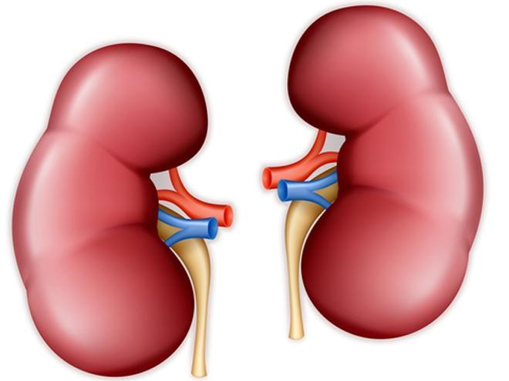
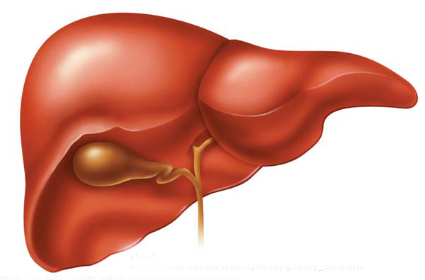
Major Sites of Elimination
Small Molecules
Biologics
Liver
Kidneys
Lysosome
All cells
Mainly metabolism
Mainly excretion
(urine)
Proteolysis
(in cells)
From Pete Bonate

Slide 35
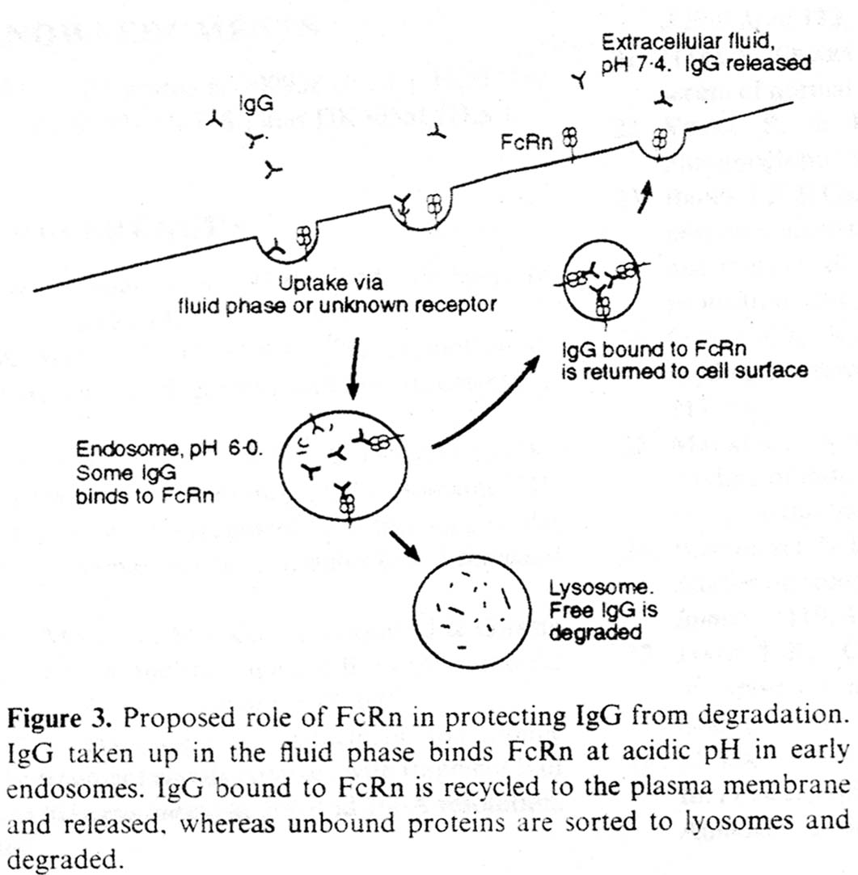
Proteins in general are eliminated through lysosomal degradation
U
Cell Membrane
Uptake via fluid phase or receptor
In lysosome, proteins are degraded
AS
This process can occur in many tissues. Endothelial cells is one major location
Notes:
Waldmann and Strober, Metabolism of Immunoglobulins, Progr. Allergy, 13:1-110, 1969
Israel EJ, et al. Increased clearance of IgG in mice that lack beta 2-microglobulin: possible protective role of FcRn. Immunology 1996; 89:573-578
Junghans and Anderson, PNAS, 93:5512-6

Slide 36
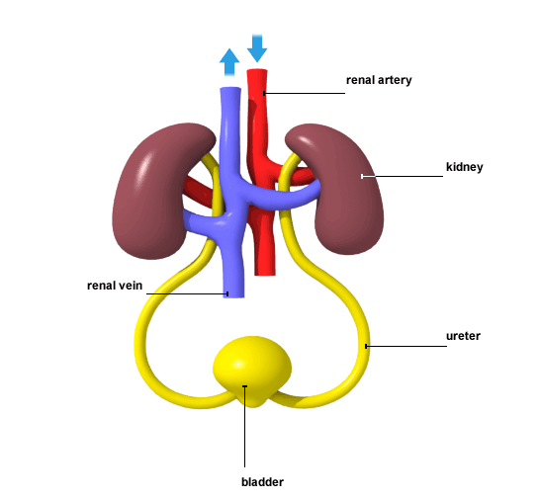
Function of Kidneys
“Cleans the blood”
Filter the blood and remove endogenous metabolic waste, such as urea, uric acid, and creatinine
Remove foreign substances
Regulate body water content, hormones, mineral composition, and acidity
Can also metabolize drugs (glucuronidation)
From Pete Bonate

Slide 37
Phase 1 Metabolism: add small polar groups. Hydroxylation
From Pete Bonate

Slide 38
Phase 2 Metabolism: add larger polar molecules
From Pete Bonate

Slide 39
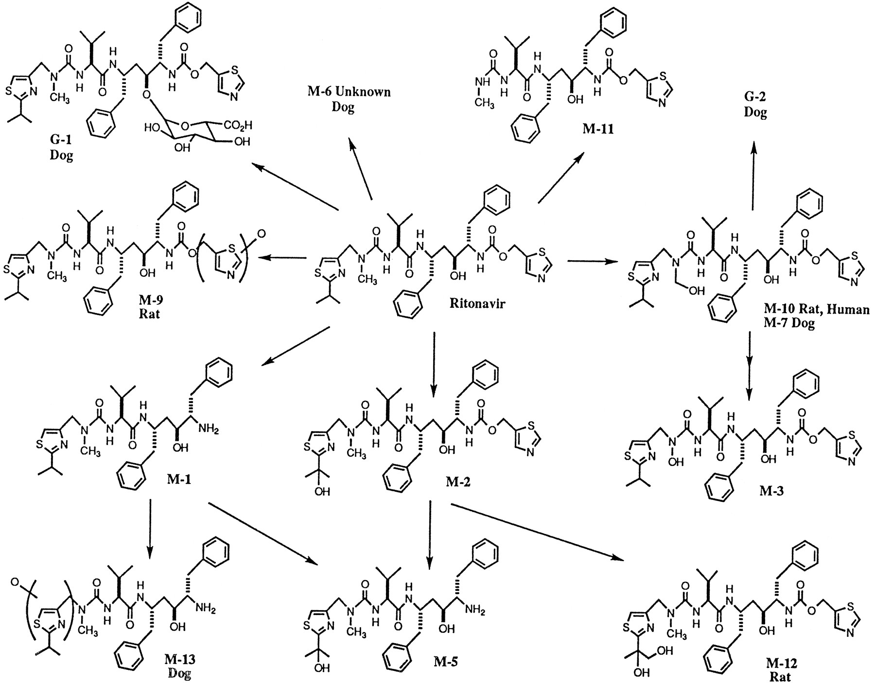
Metabolic Pathways Can Be Complex and Consist of Both Phase 1 and Phase 2 Pathways
From Pete Bonate

Slide 40
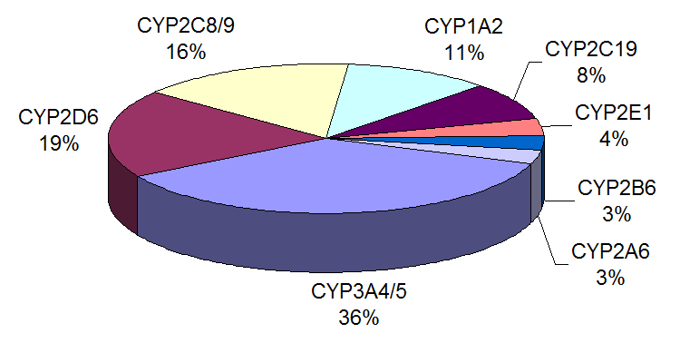
Cytochrome P450 (CYP) metabolizes drug
Catalyze most Phase I biotransformations
Found in every species and every tissue
In particular in the liver, kidney, GI tract, and brain
From Pete Bonate

Slide 41
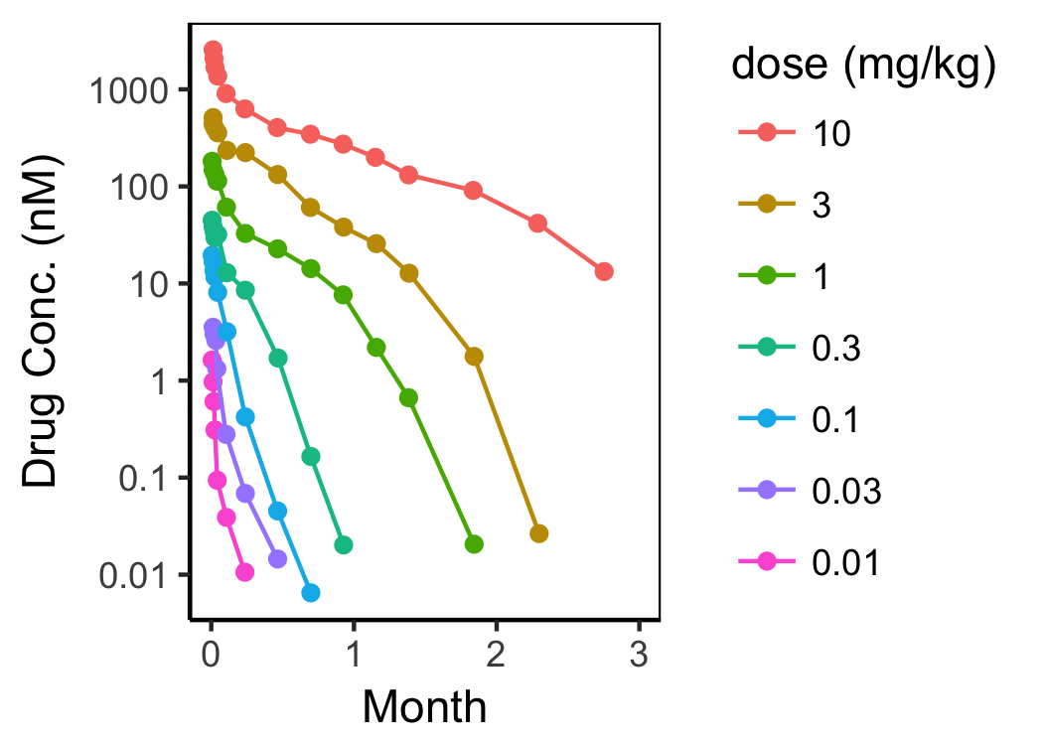
Nonlinear pharmacokinetics occurs at “critical concentration” = C_{crit}
Ccrit
Burmester, G. R. et al. Mavrilimumab, a human monoclonal antibody targeting gm-csf receptor-α, in subjects with rheumatoid arthritis: a randomised, double-blind, placebo- controlled, phase I first-in-human study. Annals of the rheumatic diseases 70, 1542–1549 (2011).

Slide 42
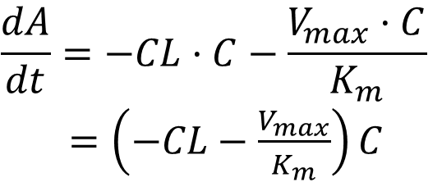
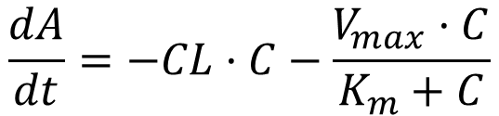
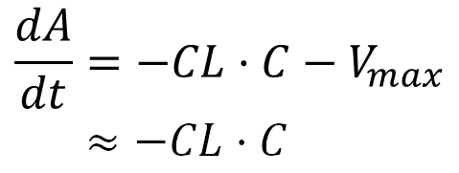
If route of elimination saturates, elimination is reduced
$$\frac{dA}{dt}=−CL·C−\frac{V_{max}·C}{K_{m}+C}$$
At small concentrations,
At large concentrations,
$$\frac{dA}{dt}=−CL·C−\frac{V_{max}·C}{K_{m}}$$
$=\left(−CL−\frac{V_{max}}{K_{m}}\right)C$
$$\frac{dA}{dt}=−CL·C−V_{max}$$
$$≈−CL·C$$
Faster elimination at lower concentrations

Slide 43
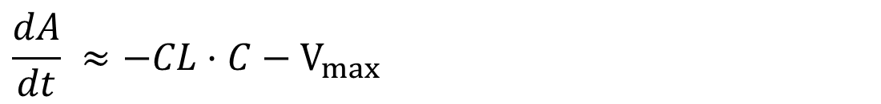
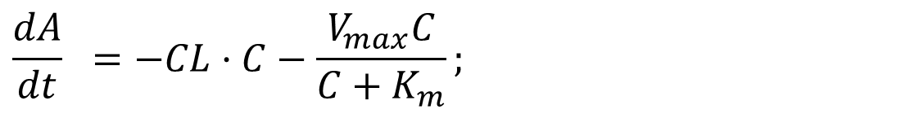
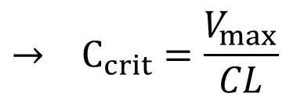
“Derivation” for C_{crit}
$$\frac{dA}{dt} =−CL·C−\frac{V_{max}C}{C+K_{m}};$$
For large doses (and concentrations), C ≫ K_{m}
$$\frac{dA}{dt} ≈−CL·C−V_{max}$$
Define C_{crit} to be where the linear (CL·C) and nonlinear (V_{m}) components contribute equally to total elimination
$$→ C_{crit}=\frac{V_{max}}{CL}$$
$$CL·C_{crit}=V_{max}$$
Stein, Andrew M., and Lambertus A. Peletier. "Predicting the Onset of Nonlinear Pharmacokinetics." CPT: pharmacometrics & systems pharmacology 7.10 (2018): 670-677.

Slide 44
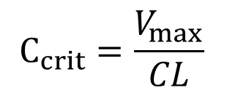
Nonlinear pharmacokinetics occurs at “critical concentration” = C_{crit}
$$C_{crit}=\frac{V_{max}}{CL}$$
Pharmacometrics is a relatively young field.
There are opportunities to analyze simple models and contribute to understanding
AM Stein and L Peletier, to appear in CPT:PSP (2018)
Presented at ACoP in 2017

Slide 45
SEE QUIZ QUESTIONS

Slide 46
Key Lessons
Clearance tells you the average concentration at steady state (given an input dosing rate)
Rate In = Rate Out = CL · C
Small molecules are eliminated mainly by the liver and the kidneys.
Large molecules (proteins) are eliminated mainly by endocytosis and proteolysis.

Slide 47
Continuous Dosing: Infusion

Slide 48
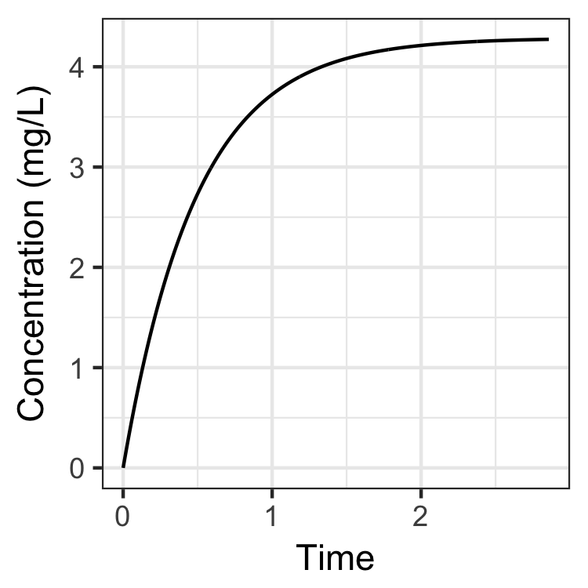
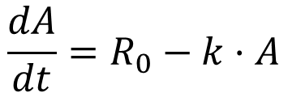
Continuous infusion
Dose Rate (R₀, mg/h)
A
k
$$\frac{dA}{dt}=R_{0}−k·A$$

Slide 49
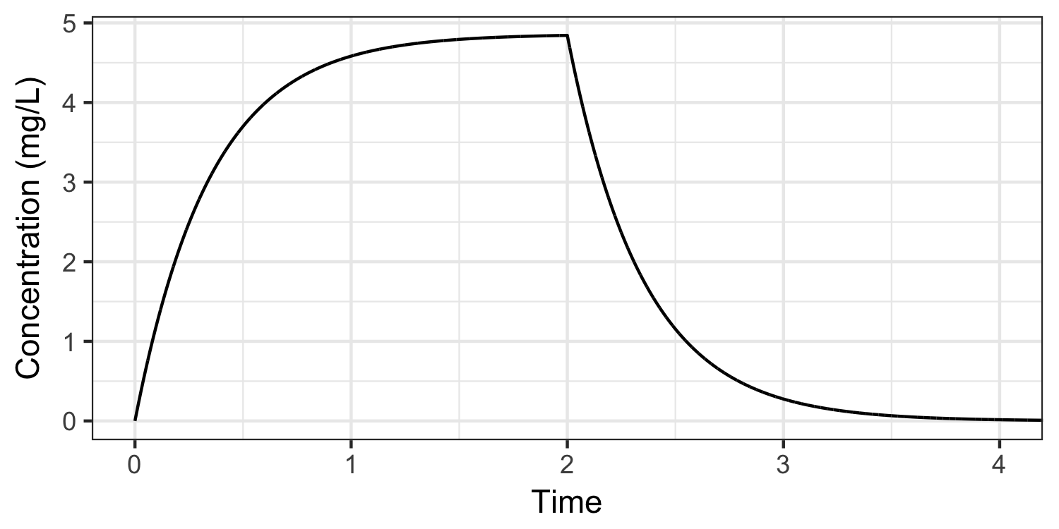
Continuous infusion

Slide 50
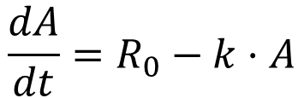
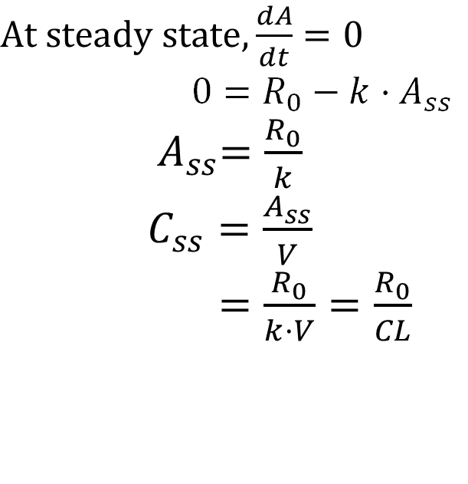
Continuous infusion
$$\frac{dA}{dt}=R_{0}−k·A$$
C_{SS}
$At steady state, \frac{dA}{dt}=0$
$$0=R_{0}−k·A_{ss}$$
${ A}_{ss}=\frac{R_{0}}{k}$
$C_{ss}=\frac{A_{ss}}{V}$
$=\frac{R_{0}}{k·V}=\frac{R_{0}}{CL}$

Slide 51
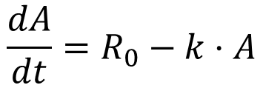
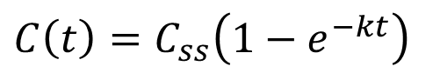


Continuous infusion
$$\frac{dA}{dt}=R_{0}−k·A$$
C_{SS}
$A_{ss}=\frac{R_{0}}{k}$, ${ C}_{ss}=\frac{R_{0}}{CL}$
$$A\left(t\right)=A_{ss}\left(1−e^{−kt}\right)$$
$$C\left(t\right)=C_{ss}\left(1−e^{−kt}\right)$$

Slide 52

At what time do you reach steady state?
C_{SS}
$$C\left(t\right)=C_{ss}\left(1−e^{−kt}\right)$$

Slide 53

Key Lesson: Sensitivity
If you double the infusion rate, you double the steady state drug concentration
If a patient has reduced clearance (e.g. due to liver impairment for a drug metabolized in liver) that reduces CL, then the steady state drug concentration is increased.
$$C_{ss}=\frac{R_{0}}{CL}$$

Slide 54
Repeated Dosing - Bolus

Slide 55


Repeated dosing
Similar to infusion dose
τ
Define τ to be the dosing interval
τ

Slide 56


Recall formula for single bolus dose and amend for dose at another time
C₁ is the response of a single dose at time 0
$$C_{1}\left(t\right) =C_{0}e^{−kt}$$
$$C_{1}\left(t−12\right) =C_{0}e^{−k(t−12)}$$

Slide 57



Each dose contributes one “bolus dose” term
During third dose (2τ-3τ)
$$C\left(t\right)=C_{1}\left(t\right) +C_{1}\left(t−τ\right) +C_{1}\left(t−2τ\right)$$
$$=C_{0}e^{−kt}+{C_{0}e}^{−k(t−τ)}+{C_{0}e}^{−k(t−2τ)}$$
Concentration
During second dose (τ-2τ)
$$C\left(t\right)=C_{1}\left(t\right) +C_{1}\left(t−τ\right)$$
$=C_{0}e^{−kt}+{C_{0}e}^{−k(t−τ)}$
During first dose (time 0-τ)
0 1 2 3
$${C\left(t\right)= C}_{1}\left(t\right)$$
$=C_{0}e^{−kt}$
Time (τ)

Slide 58



The general formula for N doses
$$C_{1}\left(t\right) =C_{0}e^{−kt}$$
$$C\left(t\right)= \sum_{n=0}^{N−1}{C_{1}(t−nτ) }$$
$$C\left(t\right)= \sum_{n=0}^{N−1}{{C_{0}e}^{−k(t−nτ)} }$$

Slide 59




This formula is a geometric series
$$C\left(t\right)= \sum_{n=0}^{N−1}{{C_{0}e}^{−k(t−nτ)} }$$
$$= \sum_{n=0}^{N−1}{{C_{0}e}^{−kt}e^{knτ} }$$
$$={C_{0}e}^{−kt}\sum_{n=0}^{N−1}{{\left(e^{kτ}\right)}^{n} }$$
As N → ∞
$$C(t)=\frac{{C_{0}e}^{−kt}}{1−e^{−kτ}}$$

Slide 60



Formulas for Cmax,ss and Cmin,ss
$$C_{max,ss}=\frac{C_{0}}{1−e^{−kτ}}$$
$$C_{min,ss}=\frac{C_{0}e^{−kτ}}{1−e^{−kτ}}$$
Recall that k and C₀ depends on both V and CL
What about average concentration C_{avg,ss}?
$$C(t)\underset{→}{N→∞}\frac{{C_{0}e}^{−kt}}{1−e^{−kτ}}$$

Slide 61








Formula for Cavg,ss (for linear PK)
$$C_{avg,ss}$$
Total drug in = Total drug out
Dose =$\int_{nτ}^{(n+1)τ}{CL·C\left(t\right)dt}$
If clearance doesn’t depend on concentration (linear)
$$AUC_{τ}$$
Dose =$CL·\int_{nτ}^{(n+1)τ}{C\left(t\right)dt}$
Dose =$CL·AUC_{τ}$
$AUC_{τ}$ =$\frac{Dose}{CL}$
$$τ$$
$C_{avg,ss}$= $\frac{AUC_{τ}}{τ}$ =$\frac{Dose}{CL·τ}$
Formula doesn’t depend on specific model for C(t)
It only requires linear clearance

Slide 62



Repeated dosing similar to infusion
Infusion: $C_{ss}=\frac{Infusion Rate}{CL}$
Repeat dose $C_{avg,ss}=\frac{Dose/τ}{CL}$
τ
Infusion Rate ~ Dose Rate
Infusion Rate ~ Dose/$τ$

Slide 63


Cool and useful result: AUC_{0-∞} = AUCτ
$$AUC_{τ}$$
$$AUC_{0−∞}$$
$$τ$$

Slide 64
AUC_{0-∞} = AUCτ Graphical Demonstration
$$AUC_{τ}$$
All earlier
doses
$$AUC_{τ}$$
Dose N-3
Dose N-3
Dose N-2
Dose N-2
Dose N-1
Dose N
Dose N-1
$$AUC_{0−∞}$$
Dose N
$$τ$$

Slide 65

AUC_{0-∞} = AUCτ Mathematical Demonstration

Slide 66





Key Insights
For IV drugs, C_{avg,ss} depends only on dose, dosing interval and clearance
Cavg = Dose/(CL·𝜏)
CL can be estimated from either $AUC_{0−∞}$ or $AUC_{τ}$
The time to steady state depends on volume and half-life.
$$AUC_{τ}$$
$$AUC_{0−∞}$$
$$τ$$
$$C_{avg,ss}=\frac{AUC_{τ}}{τ}=\frac{AUC_{0−∞}}{τ}=\frac{Dose}{CL·τ}$$

Slide 67
SEE QUIZ QUESTIONS

Slide 68
Distribution

Slide 69

Distribution
Systemic Circulation
Distribution
Other
Tissues
From Leon Aarons

Slide 70
Factors that can effect distribution
Lipophilicity (able to dissolve and move through fats)
Transport proteins can move drugs around
Blood proteins (e.g. albumin) will bind to low molecular weight drugs and prevent them from moving into tissue
From Leon Aarons

Slide 71

Profile of a single dose (Linear Space)
Dose = 10 mg
C₀ = 0.055 mg/L

Slide 72


Profile of a single dose (Log Space)
$$C\left(t\right) =Ae^{−αt}+Be^{−βt}$$
Dose = 10 mg
C₀ = 0.55 mg/L
V₁ = Dose/C₀
= 18 L
α = initial decline
= 12/h
β = terminal slope
= 0.5/h
t_{1/2β} = 1.4 h
α
β

Slide 73




Compartmental Model formulation
k₁₂
Dose
A₁
A₂
k₂₁
k₁₀
Rate of change of amount in each compartment
$$\frac{dA_{1}}{dt}=−k_{10}·A_{1}$$
$$−{ k}_{12}·A_{1}+k_{21}·A_{2}$$
$$\frac{dA_{2}}{dt}=$$
$${ k}_{12}·A_{1}−k_{21}·A_{2}$$

Slide 74






Finding the analytical solution
$$\frac{dA_{1}}{dt}=−k_{10}·A_{1}$$
$$−{ k}_{12}·A_{1}+k_{21}·A_{2}$$
$$\frac{dA_{2}}{dt}=$$
$${ k}_{12}·A_{1}−k_{21}·A_{2}$$
$$\frac{d}{dt}\left({A_{1} \atop A_{2}}\right)=\left(\begin{matrix}−{(k}_{10}+k_{12}) & { k}_{21} \\ { k}_{12} & −k_{21}\end{matrix}\right)\left({A_{1} \atop A_{2}}\right)$$
M
α and β are the eigenvalues of M
A and B come from the eigenvectors of M and the initial dose
Details in www.pfim.biostat.fr/PFIM_PKPD_library.pdf

Slide 75

Compartment model and prolife each have 4 parameters
$$C\left(t\right) =Ae^{−αt}+Be^{−βt}$$
A+B
α
B
β
Dose (V₁)
k₁₂
A₁
A₂
k₂₁
k₁₀

Slide 76

Elimination from the peripheral compartment not identifiable.
$$C\left(t\right) =Ae^{−αt}+Be^{−βt}$$
A+B
α
4 parameters
of information
5 parameters
In model is too many
B
β
Dose (V₁)
k₁₂
A₁
A₂
k₂₁
k₁₀
k₂₀

Slide 77
Alternative parameterization for 2 compartment model
{V₁, k₁₀, k₁₂, k₂₁}
{V₁, CL, Q, V₂}
Dose (V₁)
Dose (V₁)
V₂
k₁₂
Q
A₁
A₂
A₁
A₂
k₂₁
k₁₀
CL
CL = k₁₀·V₁
Q = k₁₂·V₁
V₂ = V₁·(k₁₂/k₂₁)

Slide 78




Clearance still relates to the Area Under the conc. Curve ($AUC_{0−∞}$) for any number of compartments
Total drug in = Total drug out
Dose =$\int_{0}^{∞}{CL·C\left(t\right)dt}$
If clearance doesn’t depend on concentration (linear)
Dose =$CL·\int_{0}^{∞}{C\left(t\right)dt}$
Dose =$CL·AUC_{0−∞}$
$$AUC_{0−∞}$$
$AUC_{0−∞}$ =$\frac{Dose}{CL}$

Slide 79

Be careful in interpreting parameters from the model
Directly observable params:
V₁ = Dose/C₀
CL = $AUC_{0−∞}$ = $AUC_{τ}$
“Apparent” parameters
V₂ is not a physiological volume and harder to “identify” from data
C₂ = A₂/V₂ is not a meaningful concentration and should never be used
Dose (V₁)
V₂
Q
A₁
A₂
CL

Slide 80
In the two compartment model, “volume of distribution” is a function of time
Recall that volume of distribution relates amount in body to concentration measured in circulation.
For 1 compartment model:
C(t) = A(t)/V
There is only one volume.
For a two compartment model with central CL, there are:
Two volume parameters: V₁ and V₂.
There is also a volume function: C(t) = A(t)/V(t)
At time 0, C(0) = A(0)/V₁
After a single dose, at long times, C(t) = A(t)/V_{z} where V_{z} = CL/β
At steady state after multiple doses:
C(t_{ss}) = A(t_{ss})/V_{ss} where: V_{ss} = V₁·[1 + k₁₂/k₂₁]

Slide 81

Sketch of derivation of V_{z} and V_{ss}
For the derivation, we start with the definition of V(t)
To derive V_{z} and V_{ss}, we then:
Use the analytic expression for C(t) for the either single dose (V_{z}) or multiple dose (V_{ss})
Take the limit as t→∞
$$V\left(t\right)=\frac{A(t)}{C(t)}=\frac{Dose−CL\int_{0}^{t}{C\left(t\right)dt}}{C(t)}=\frac{CL}{C(t)}\int_{t}^{∞}{C\left(t\right)dt}$$

Slide 82
Really, there are many more peripheral compartments, but the 2 compartment approximation often works
Occasionally, we use a
3 compartment model
Dose (V₁)
V₃
V₂
Q₁₃
Q₁₂
A₃
A₁
A₂
CL

Slide 83
Really, there are many more peripheral compartments, but the 2 compartment approximation often works
https://www.researchgate.net/figure/n-the-physiologically-based-pharmacokinetic-PBPK-model-organs-important-for-ADME-are_fig1_313177067
(wikipedia for PBPK)

Slide 84
Key Lessons
Distribution leads to two (or more) compartment kinetics
Multiple “half-lives” are observable in the data.
Even for two models, AUC_{0-∞}, AUC_{τ} and C_{avg,ss} are still driven by CL, when CL is independent of concentration
This result holds for any number of compartments
The volume becomes a function of time and the behavior of this function at time zero (V₁) or as time goes to infinity (V_{z}, V_{ss}) are often what is reported

Slide 85
See Quiz Questions

Slide 86
Absorption and bioavailability

Slide 87
Routes of Administration (examples)
Nasal (nose)
Oral (mouth)
Inhalation (lung)
Intravenous (vein)
Intramuscular (muscle)
Subcutaneous (under skin)
Transdermal (skin patch)

Slide 88
Oral dose of drug is absorbed through the gastrointestinal tract
Wikipedia

Slide 89


Bioavailability (some drug is lost)
(
systemic
circulation
Oral
dose
small
molecule
Oral
Absorption
Intestinal
First Pass Elimination
Hepatic
First Pass Elimination
Subcutaneous
Absorption
Inject Site
First Pass Elimination
Lymphatic
First Pass Elimination
Subcutaneous
dose
biologic
Skin
Lymph
node
To thoracic duct
and blood
Dose
AJM
Notes:
For mAbs, injection site and lymphatic first pass elimination are not yet possible to predict. If the lymphatic system were to express high levels of a drug target, it is possible that only a small fraction of a subcutaneously injected drug will make it to the thoracic duct and hence the blood; i.e. the bioavailability could be rather low and dependent on both dose level and perhaps disease specific target expression.

Slide 90

Oral dose vs intravenous dose
Intravenous Bolus
 | IV Bolus | Oral
Absorption | No | Yes
Initial conc. (C0) | Dose/V1 | 0
Time of max conc. | 0 | >0
AUC_{0-∞} | Dose/CL | < Dose/CL
Terminal slope | β | β
β
Oral Dose

Slide 91

Oral Dose
Cumulative drug
absorbed over time
At Tmax, absorption has essentially stopped
Increasing
concentrations
are due to drug
absorption
Declining
concentrations
are due to drug
elimination from
the body

Slide 92





Compartment Model with Absorption (called 2 compartment model with oral absorption)
F, k_{a}
k₁₂
Dose
A_{depot}
A₁
A₂
k_{a} = absorption rate
F = bioavailability [0-1]
fraction of drug
absorbed
k₂₁
k₁₀
absorption
elimination
distribution
$$\frac{dA_{depot}}{dt}= −k_{a}·A_{depot}$$
$$\frac{dA_{1}}{dt}=F·k_{a}·A_{depot}$$
$$−k_{10}·A_{1}$$
$$−{ k}_{12}·A_{1}+k_{21}·A_{2}$$
$$\frac{dA_{2}}{dt}=$$
$${ k}_{12}·A_{1}−k_{21}·A_{2}$$

Slide 93

Application – extended release prolongs exposure and can improve safety (reduce peak-trough ratio)
k_{a} = 0.03/h
k_{a} = 0.3/h

Slide 94

More complex absorption models can be developed
Abuhelwa, Ahmad Y., et al. "Food, gastrointestinal pH, and models of oral drug absorption." European Journal of Pharmaceutics and Biopharmaceutics 112 (2017): 234-248.

Slide 95
Question
How would you expect changing the rate of absorption(ka) to affect the average drug concentration at steady state?
How does changing the bioavailability affect the average drug concentration

Slide 96





Updating average concentration formula
Total drug in = Total drug out
F·Dose =$\int_{nτ}^{(n+1)τ}{CL·C\left(t\right)dt}$
If clearance is linear
F·Dose =$CL·\int_{nτ}^{(n+1)τ}{C\left(t\right)dt}$
F·Dose =$CL·AUC_{τ}$
$AUC_{τ}$ =$\frac{F·Dose}{CL}$
$C_{avg,ss}$= $\frac{AUC_{0−∞}}{τ}$ =$\frac{F·Dose}{CL·τ}$
Formula doesn’t depend on absorption, but it does depend on F

Slide 97
Key Lessons
When drugs are given by alternative routes to intravenous (e.g. oral, subcutaneous, etc.), they must be absorbed before entering blood stream.
Some of the drug may be lost before entering the blood.

Slide 98
Allometric Scaling
Effect of body size on PK parameters

Slide 99





Often, we want to predict PK in humans from animal data
Slope of line ~ ¾ in log-space
Moore, Brioni R., et al. "Pharmacokinetics, pharmacodynamics, and allometric scaling of chloroquine in a murine malaria model." Antimicrobial agents and chemotherapy 55.8 (2011): 3899-3907. Pictures from wikipedia

Slide 100
Many biological processes scale with body weight
Many fundamental biological processes scale with weight (WT) in a surprisingly simple way.
Volume ~ WT
Metabolic Rate ~ WT^{3/4}
Lifespan ~ WT^{1/4}
Heart rate ~ WT^{-1/4}
Length of aorta ~ WT^{1/4}
Height of tree ~ WT^{1/4}
All mammals (from hamster to elephant) have about 1 billion heart beats during their lifetime
(Heart rate)·(Lifespan) = WT⁰
West, Geoffrey B., and James H. Brown. "The origin of allometric scaling laws in biology from genomes to ecosystems: towards a quantitative unifying theory of biological structure and organization." Journal of experimental biology 208.9 (2005): 1575-1592.

Slide 101

Metabolic rate ~ WT^{3/4}
slope = 3/4
Mammals
Elephant
Shrew
log (metabolic power)
Cells
slope = 3/4
West, Geoffrey B., and James H. Brown. "The origin of allometric scaling laws in biology from genomes to ecosystems: towards a quantitative unifying theory of biological structure and organization." Journal of experimental biology 208.9 (2005): 1575-1592.
Mitochondria
log (weight)

Slide 102
The reason for metabolism ~ WT^{3/4} is to maximize surface area (SA)
Evolution maximizes surface area (SA), in order to maximize nutrient absorption and metabolism.
For standard geometries (cube, sphere), surface area relates to length (L), volume (V), and weight (WT) by:
SA ~ L²
V ~ L³
SA ~ V^{2/3} ~ WT^{2/3}
Because evolution pushes life to maximize surface area and a little more area can be obtained using the “fractal dimension,” the maximum possible exponent is ¾.
Therefore, SA ~ WT^{3/4} > WT^{2/3}

Slide 103
Blood vessels follow fractal patterns
https://blogs.uoregon.edu/artofnature/2013/12/03/fractal-of-the-week-blood-vessels/
https://dejavouz.wordpress.com/reflections/tree2/

Slide 104


A fractal is a self similar as you zoom in to smaller scales

Slide 105
An example of building a fractal
Length
Koch Curve
1
each line is 1/3 the size of the original line. But now there are 4 segments (instead of 3)
4/3 = 1.3
60°
16/9 = 1.8
64/27 = 2.4
256/81 = 3.2
4^{n}/3^{n}→∞
Fractal
fractal dimension =
log(4)/log(3) = 1.26

Slide 106
Fractal geometry can increase the dimensionality of the space
0°
D = 1
D = 1.26
D = 2
0°
30°
60°
90°
angle of triangle
The largest a fractal dimension can be is 1 + spatial dimension
The surface area can go from 2 → 3 dimensions
https://www.researchgate.net/figure/Von-Koch-curve-with-bend-angle-from-0-to-90-degrees_fig1_309391846

Slide 107
Life has found a 4th dimension using fractal geometry! This is why CL ~ WT^{3/4}
For “normal” shapes:
SA ~ L²
V ~ L³
SA ~ V^{2/3} ~ WT^{2/3}
For blood vessels
SA ~ L³
V ~ L⁴
SA ~ V^{3/4} ~ WT^{3/4}
1. West, Geoffrey B., James H. Brown, and Brian J. Enquist. "The fourth dimension of life: fractal geometry and allometric scaling of organisms." Science 284.5420 (1999): 1677-1679.

Slide 108
Key Lessons
Generally
Clearance scales with CL ~ WT^{3/4}
Volume scales with V ~ WT
This CL ~ WT^{3/4} scaling is a rule of thumb and does not always apply. Important caveats:
Differing mechanisms of drug metabolism across animals
Difference between “lean body weight” and total body weight
Differences in metabolism with age, especially under 1 year old.
In practice, estimating the exponent for a particular drug can be challenging due to the limited range in weights that are tested. Often, the ¾ exponent is assumed.

Slide 109
Where PK measurements and models are used

Slide 110
Bioequivalence Postulate
If the concentration-time profiles for two drugs or dosing conditions are the same then efficacy and toxicity should be the same
Basis for generic drugs
Basis for formulation changes
Basis for examination of drug interactions, food effects, etc.
From Pete Bonate

Slide 111

Mean clozapine plasma concentrations after 7 days of 100 mg BID for 2 formulations in 18 schizophrenic subjects
Tassaneeyakul W et al. Steady-state bioequivalence of clozapine tablet in schizophrenic patients. J Pharm Pharmaceutic Sci 8, 47, 2005
From Pete Bonate

Slide 112

For drugs that are cleared by kidney, kidney function will affect exposure
~ Measure of kidney function
Roland and Tozer, Figure 13-14

Slide 113
Some factors that may impact drug concentrations
Factor | Parameter | Mechanism
Liver and kidney function | CL | Small molecules that are cleared by liver and kidneys
Weight | CL, V | Relates to size of patient (V) and metabolizing tissue (CL)
Comedications (e.g. CYP inhibitor) | CL | Affects function of metabolizing enzyme
Comedications (proton pump inhib) | F, ka | Affects gut pH and how well it absorbs drugs
Taken with food | F, ka | Impacts how drug is absorbed
Genetics (CYP variants) | CL | Some CYPs are polyclonal

Slide 114
Backups

Slide 115
Acetaminophen Overdose
Acetaminophen is Phase 2 conjugated by glutathione
Large doses deplete the glutathione and sulfate pools
Toxic metabolite then binds to cellular macromolecules
Clinical course:
Nausea, vomiting (Day 1)
Hepatic enzymes ↑, right upper quadrant sensitive to touch (Day 2 to 3)
Hepatic necrosis, possibly renal failure, and cardiac abnormalities (Days 3 to 5)
From Pete Bonate

Slide 116
Smallest dose recorded for hepatotoxicity in adults is 5.4 g
10 g is lethal
Therapy is targeted at repleneshing sulfate pools
From Pete Bonate

Slide 117
Biliary Elimination
Bile is secreted from the liver to the gallbladder and to the the intestine
Bile aids absorption of fats
breaks down large fat globules into smaller ones
Drugs may be excreted by biliary route
Liver
Gall-
bladder
Bile
Duct
Intestine
From Pete Bonate and wikipedia

Slide 118
Definition of a dimension
Let N = number of shapes (sticks, squares or cubes) needed to cover a big shape.
Now reduce the length of each side of shape by a factor ε (e.g. 1/3)
Then the dimension (D) is such that: N ~ ε^{-D}
ε = 1
ε = 1/2
ε = 1
ε = 1/3

Slide 119
For normal shapes, surface area relates to weight by 2/3 power
L
R
Cube
SA = 6L²
V = L³
SA = c₁·V^{2/3} ~ WT^{2/3}
c₁ is a constant
Sphere
SA = 4𝜋R²
V = (4/3)𝜋R³
SA = c₂·V^{2/3} ~ WT^{2/3}
c₂ is a constant
As V increases, SA increases too, but the SA:V ratio decreases.
This 2/3 ratio holds at the macroscale, but on the microscale, it can be possible for SA to have > 2 dimensions.

